Slide 1




DITTY
Decentralized kitty party
(AKA) chit fund application

Slide 2


PROBLEM STATEMENT
Organizer Reliance: Kitty parties, typically informal gatherings among close friends for lending and borrowing money, traditionally rely heavily on a single organizer to manage all the funds, leading to potential trust issues and inefficiencies.
Operational Costs: Traditional kitty parties come with elevated operational expenses related to paperwork, in-person meetings, and administrative overhead, reducing the overall value for participants.
High Administrative Fees: Chit fund companies implementing these schemes often impose steep administrative fees, which diminishes participants' earnings and borrowing capacity.
DITTY

Slide 3
PROBLEM STATEMENT
Fraudulent Schemes: Many individuals have fallen victim to scams orchestrated by fraudulent companies that abscond with collected funds, highlighting the need for increased security and transparency.
Geographical Limitations: Physical location often acts as a barrier, restricting participation for close-knit circles and limiting the inclusivity of such schemes.
Shift in Social Dynamics: People's increasingly hectic schedules have led to a change in mindset, favoring virtual interactions over traditional in-person meetings.
DITTY

Slide 4

BENEFITS OF DITTY
Eliminates the need for a single organizer, fostering trust and efficiency through automated fund management.
Reduces operational expenses, preserving more value for participants by eliminating paperwork and in-person meetings.
Minimizes administrative fees, enhancing earnings and borrowing capacity for participants.
Ensures security and transparency, protecting participants from fraudulent schemes and fund mismanagement.
Breaks down geographical barriers, allowing wider participation and inclusivity.
Caters to evolving social dynamics, accommodating virtual interactions, for seamless participation in lending and borrowing activities.
Increases accountability to make it no more daunting to lend money to friend
Eliminates the need for compliance or KYC requirements for leading and borrowing money
DITTY

Slide 5



Existing players solving it...but poorly
Traditional Chit Fund Companies
Individuals Running Traditional Chit Funds
Lack of Technological Innovation: Traditional chit fund companies often rely on manual processes and paperwork, leading to inefficiencies and slower operations.
Lack of Legal Framework: Individuals running traditional chit funds may operate in a regulatory gray area, which can lead to legal issues and lack of participant protection.
Limited Accessibility: Traditional chit fund companies typically serve a localized market, limiting their reach and accessibility to a broader audience.
Trust Dependency: Participants rely heavily on the integrity and trustworthiness of the individual running the chit fund, which can be risky.
Higher Administrative Costs: They may incur higher administrative costs due to the need for physical offices, staff, and paperwork, which can lead to increased fees for participants.
Limited Scalability: Traditional chit funds managed by individuals have limited scalability potential due to manual operations and trust-based systems.
Reduced Participant Network: Individuals may have a smaller network of participants, which could limit the variety and size of chit fund groups.
Security Concerns: Handling cash and physical documents can pose security risks, making participants vulnerable to potential fraud or theft.
DITTY

Slide 6
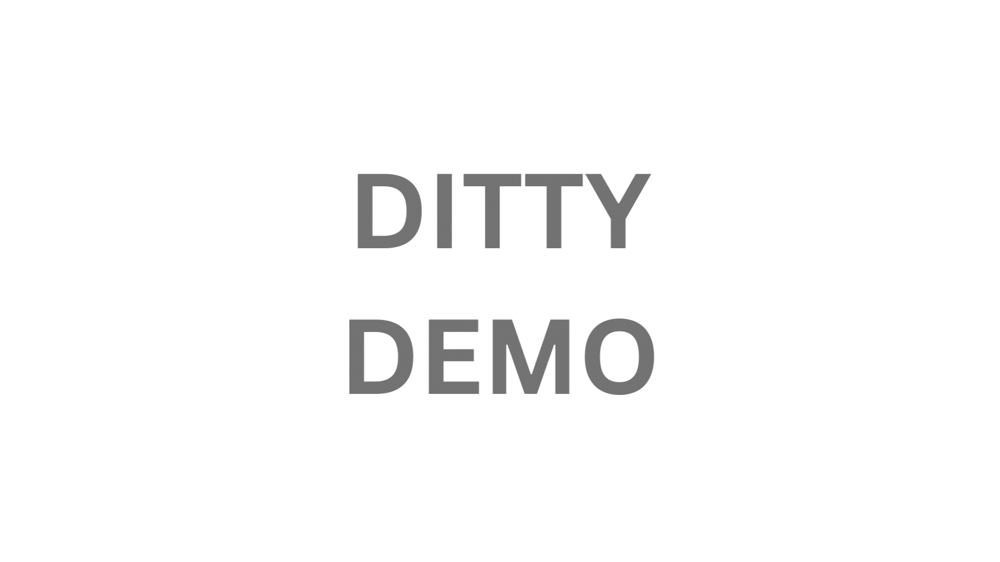
DITTY DEMO

Slide 7


Making it happen (Use-cases)
Current
Near Future
Distant Future
Creating and Running a ChitFund
Use the Solana MainNet
Lauching our own token and Governance
Improving the UI, and bidding experience
Launching, a staking protocol along side ChitFunds
Integration with Solana Devnet
Bring benefits to the Organiser, like NFT’s and Rewards
DITTY

Slide 8


Why Now?
The widespread availability of digital infrastructure, including smartphones and the internet, enables users to access and use the application conveniently.
The success of this idea today is primarily due to a need for a Decentralised and transparent ChitFund System, which is very tradition and on paper in nature
The emergence of blockchain technology, which offers transparency, security, and smart contract capabilities
Increased globalization has created diverse, interconnected communities with shared financial goals.
.
DITTY

Slide 9

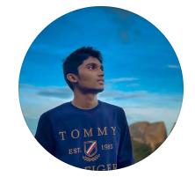



Why are you the one to do it?
Lokesh
Adithya
Lokeshwaran is a Rust Smart Contract Developer with 7+ years of experience in software industry
FrontEnd, UI and integration with Smart Contracts
Won a hackathon based on blockchain technology, and participated in a few.
Had a basic knowledge of Rust programming which is used in solana bockchain.
Because we were passionate enough to complete this project.
Chethana
Amit
FrontEnd and UI Developer
Testing and Marketing
DITTY

Slide 10
Here is how we make/will make money...
1$
ADs
FIXED CONTRACT CREATION FEE
REVENUE
Advertising: The dApp could sell advertising space to businesses that want to reach its users. This would be a relatively low-effort way to generate revenue, but it is important to ensure that the ads are relevant to the dApp's users and do not disrupt their experience.
DITTY

Slide 11
















Where will we be next year if we win the hackathon/raise funds?
Working on the Finance Model and including fees for the ChitFund
Marketing and Community Building
Adding Support for other Coins
Working on a Token and Governance
Deploying on the MainNet and imporving the UI
Q1 (2024)
Q2 (2024)
Q3 (2024)
Q4 (2024)
DITTY

Slide 12


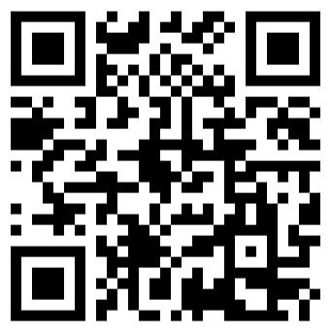


ditty.solana@gmail.com
+91 99944 21694
DITTY
Twitter- @ditty_solana
A Decentralized kitty application which is a type of financial application that allows users to create and manage kitty parties in a trustful and secure manner.
https://ditty-sol.vercel.app/

